Slide 1
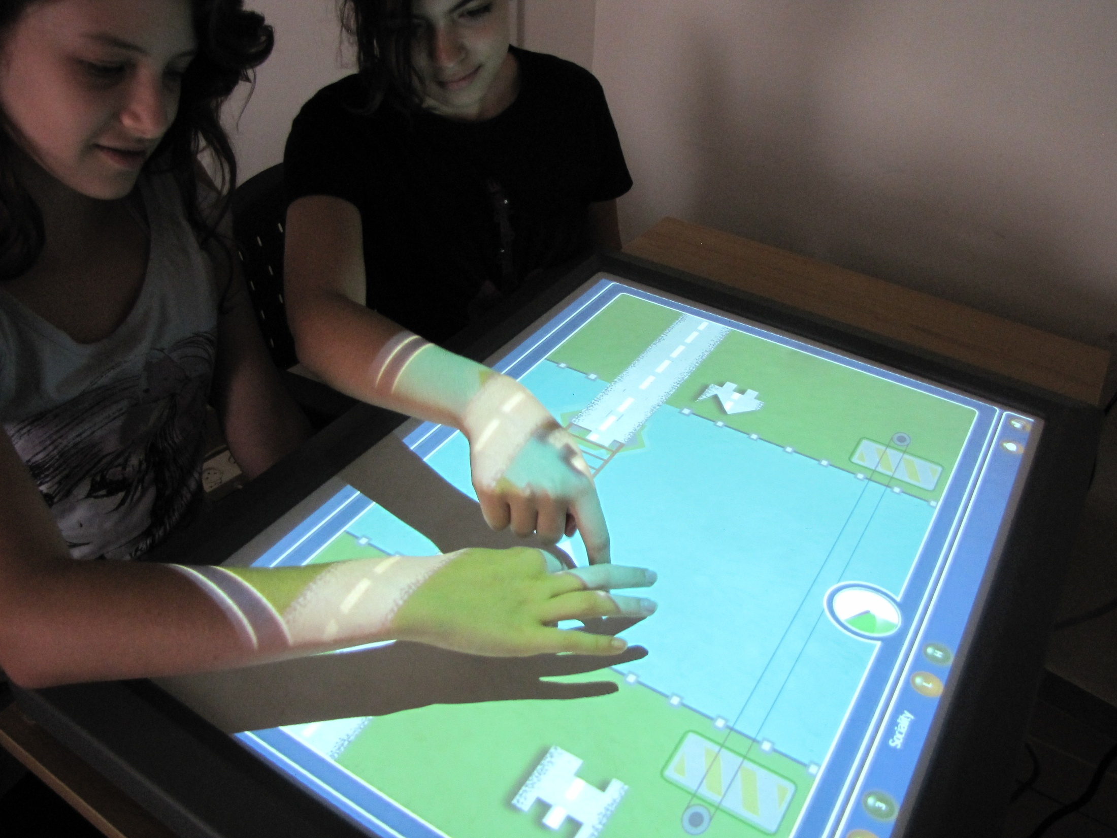
Usability of a Multi-Touch Tabletop Surface to Enhance Social Competence Training for Children with Autism Spectrum Disorder
Patrice L. (Tamar) Weiss Eynat Gal University of Haifa | Massimo Zancanaro Francesco Telch Fondazione Bruno Kessler | Sigal Eden Bar Ilan University Open University
Notes:
I would like to thank the organizers of the 18th International Conference of the Society for Posture and Gait Research, and, in particular, Joyce Fung, John Jeka and Sharon Henry for giving me this opportunity to speak to you. I apologize that I am doing this via a pre-recorded talk that is being given from a distance but, for family reasons, I was unable to travel to the USA. It actually gives me an opportunity to illustrate the main point of my talk – the ways in which technology can help us but, at the same time, ways in which we are often not yet able to take full advantage of it. On the one hand, technology greatly facilitated the communication between myself and the conference organizers and enabled me to send a bulky presentation without recourse to snail mail, or courier, etc. On the other hand, it proved to be too expensive and cumbersome to take advantage of technologies such as videoconferencing and IP voice in order to enable to fully interactive session. Over the next 40 minutes, I plan to use some examples from my current research interests to illustrate both the hope and the frustration that technology currently evokes in clinical realms.

Slide 2






Massimo Zancanaro, Leonardo Giusti
Sue Cobb, Tony Glover, Laura Millen
Sarah Parsons, Sara Garib-Penna
Nirit Bauminger, Sigal Eden
Patrice L. (Tamar) Weiss, Eynat Gal

Slide 3
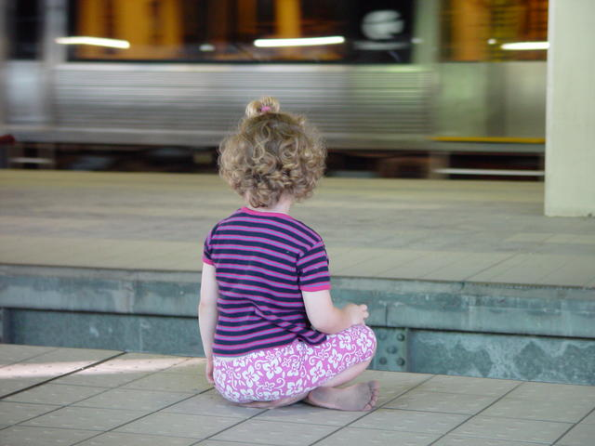
Goal
Enhancing social competence for children with Autism Spectrum Disorder
Social Competence entails reciprocity between the way the individual thinks, feels, behaves in different social contexts and situations
Children with Autism Spectrum Disorder have:
Limited social knowledge of norms and constructs
Deficient social information processing
  e.g., fixation on peripheral details in social situations
  (Lord & Magill-Evans, 1995; Sigman & Ruskin, 1999; Stone & Caro-Martinez, 1990)

Slide 4
Cognitive Behavioral Therapy
Children think and children act :
how they think—or appear not to think— is usually related to how they act
CBT focuses on changing distorted information processing rebuilding adaptive processing of world by combining Learning & Experiencing
(Hart & Morgan, 1993; Kendall & Panichelli-Mindel, 1995; Bauminger 2002; Braswell, 1995; Graham, 2005; Hart & Morgan, 1993; Kendall, 2000)
Theory
Cognitive Behavioral Therapy
CBT

Slide 5
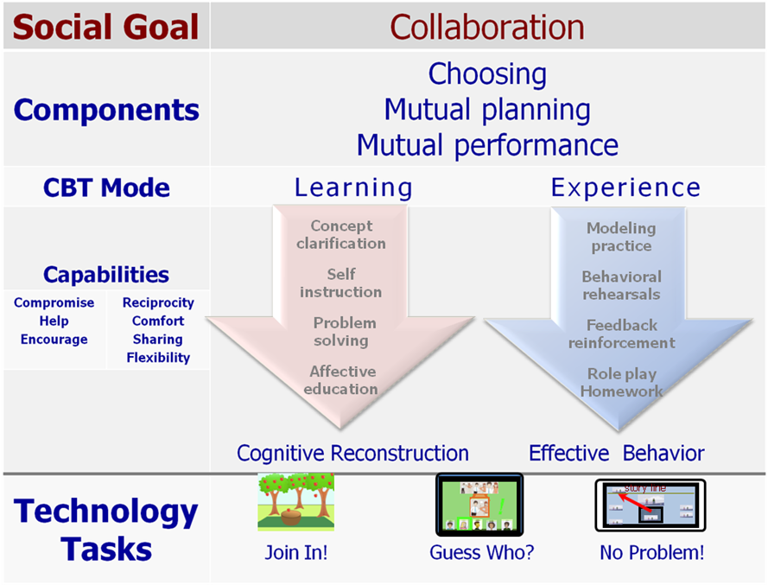
Cognitive Behavioral Therapy
Theory
Cognitive Behavioral Therapy
CBT

Slide 6
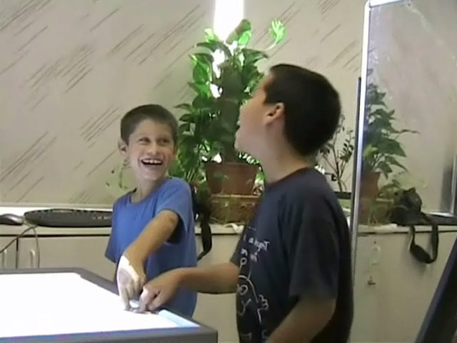
Collaborative Interactions
Theory
Collaborative Interactions
 | Constraints on …
 | Objects | User-object relations | Roles | Context
Joint Performance
Mutual Planning
Sharing
Negotiate & Compromise

Slide 7
Collaborative Interactions
Theory
Collaborative Interactions
 | Constraints on …
 | Objects | User-object relations | Roles | Context
Joint Performance | to do an action together
Mutual Planning | to plan and perform a task together
Sharing | to share personal resources to achieve a common objective
Negotiate & Compromise | collaboration is discussing in order to construct a shared meaning

Slide 8
Collaborative Interactions
Theory
Collaborative Interactions
 | Constraints on …
 | Objects | User-object relations | Roles | Context
Joint Performance
Mutual Planning
Sharing
Negotiate & Compromise
joint actions on an object modify its beha-vior
objects belong to one user who can share it with others
each user able to perform specific set of actions
relations between resources create need to cooperate to solve a problem

Slide 9
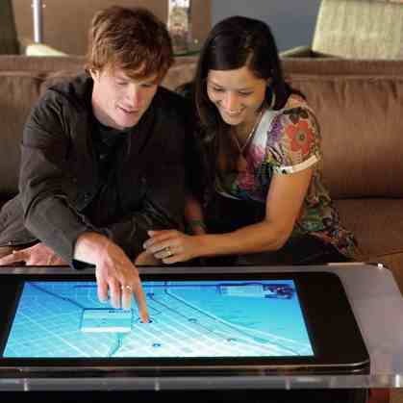
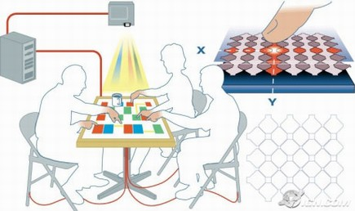
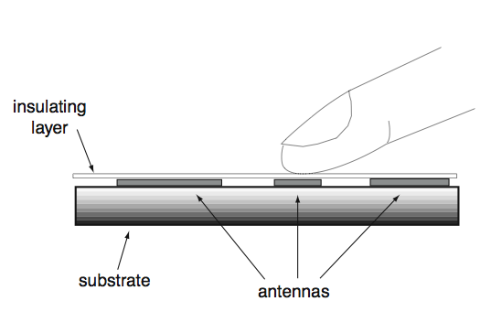
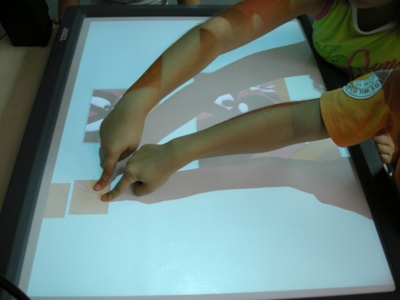
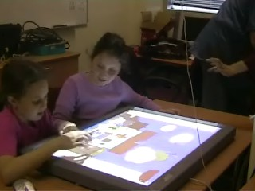
Diamond Touch Multi-User Touch Table
Technology
Shared Active Surface

Slide 10
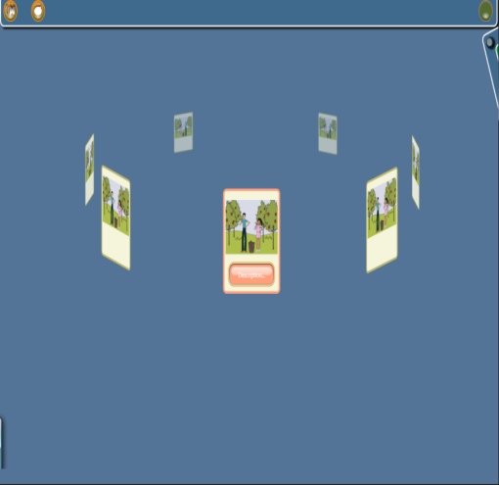
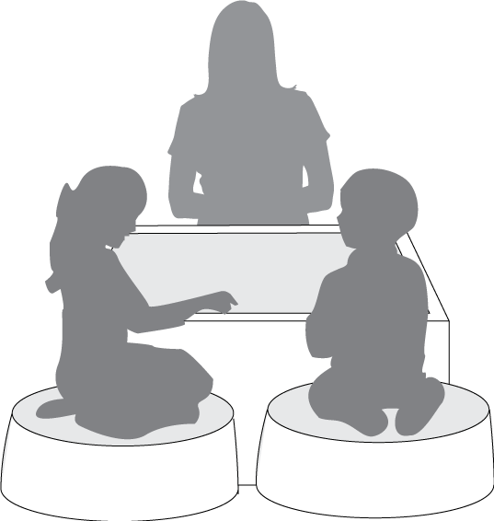
“Join In” Suite
3 users: 1 facilitator and 2 children
Implementation
“Join In” Suite

Slide 11
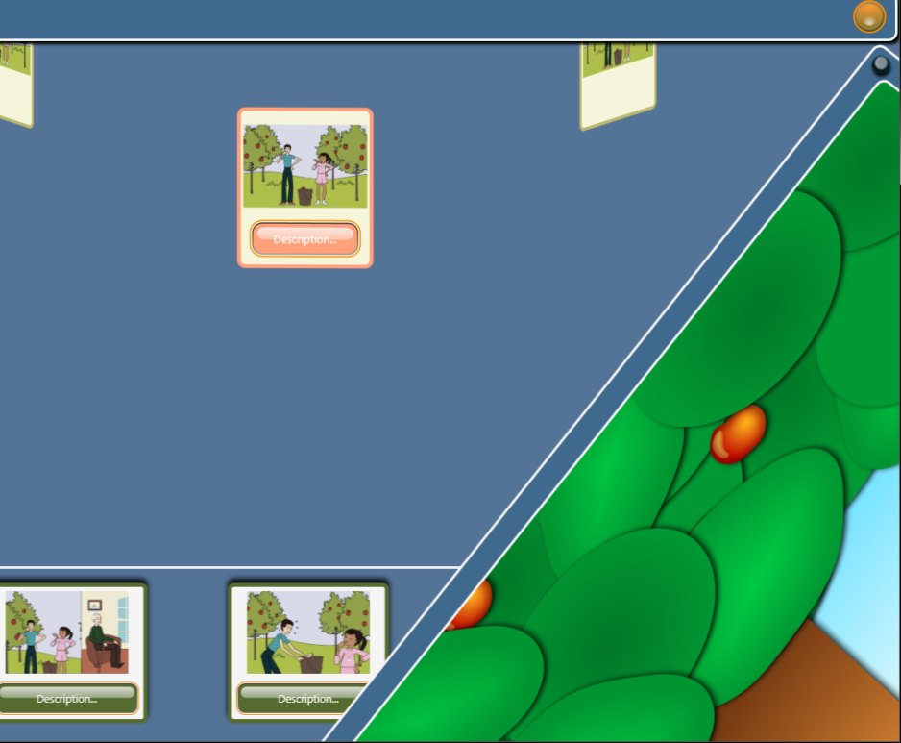
“Join In” Suite
At any point during the session, the facilitator can decide to move from the “learning” part to the “experience part”

Slide 12
“Join In” Suite
Implementation
“Join In” Suite
 | Constraints on …
 | Objects | User-object relations | Roles | Context
Joint Performance | Apple Orchard
Mutual Planning |  |  | Save the Alien
Sharing |  | Bridge
Negotiate & Compromise |  |  |  | Hungry Ducks

Slide 13
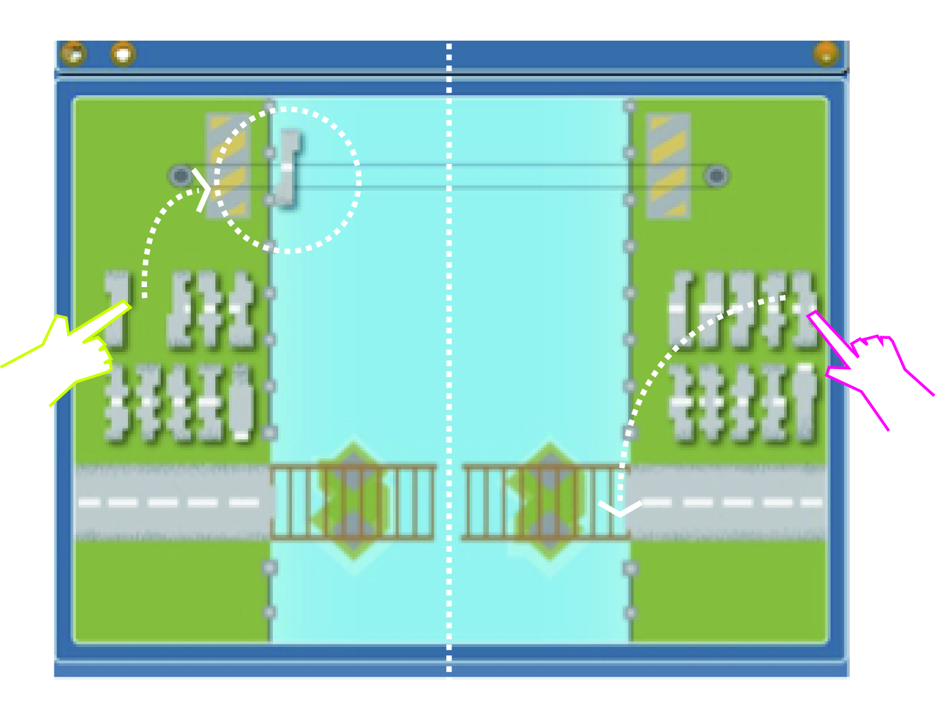
Bridge: constraints on user-object relations + sharing
Social task - to rebuild a bridge that collapsed, in order for people from both sides (cities) to reconnect.
Ownership pattern Each child can operate only pieces on his side.
Ownership pattern requires asking for and giving help.

Slide 14
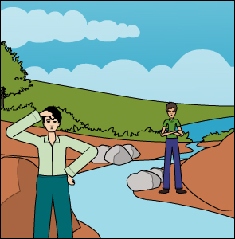
“Join In” Suite: Learning Part for Bridge
Social problem is presented.
A bridge that connects BigTown and NiceTown has collapsed! The citizens collected all the stones from the water but they have been mixed-up.
Some of the stones from Big town are now on Nice town's side and some of the stones from Nice-town are on Big town's side.
Mike from BigTown and John from NiceTown are in charge of rebuilding the bridge. They each can use their own stones on their town's side of the bridge.
They can use the rope to transfer stones from one side to the other. How can they rebuild the bridge?

Slide 15
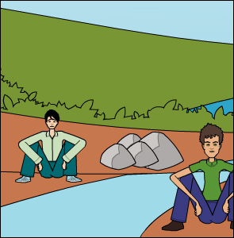
“Join In” Suite: Learning Part for Bridge
Children listen to and select alternate solutions. Can also record their own solution
Receive feedback on why or why not a solution is appropriate (collaborative)
John and Mike say that the job is too complicated, the bridge will collapse again anyway and the citizens should just cross the river by boat.
It’s a pity to stop trying. It will be much easier for the citizens to stay in touch with each other if they can use the bridge to cross from one city to the other.

Slide 16
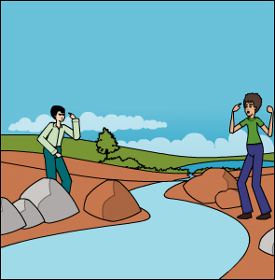
“Join In” Suite: Learning Part for Bridge
Children listen to and select alternate solutions. Can also record their own solution
Receive feedback on why or why not a solution is appropriate (collaborative)
John and Mike argue. Each of them wants to complete his own part as soon as possible and prefers to work on his side first.
Oh, what a pity!!! The time they spend arguing could have been used to build the bridge.

Slide 17
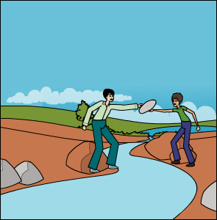
“Join In” Suite: Learning Part for Bridge
Children listen to and select alternate solutions. Can also record their own solution
Receive feedback on why or why not a solution is appropriate (collaborative)
Mike and John decide to cooperate: They exchange some stones so that each of them gets the ones he needs until they both finish building their parts.
Great!!! This way the bridge will be built again soon!!! Cooperation is the best way.

Slide 18
“Join In” Suite: Experience Part for Bridge
Children play a game that reinforces the same collaboration pattern that they just learned about or are going to learn.

Slide 19
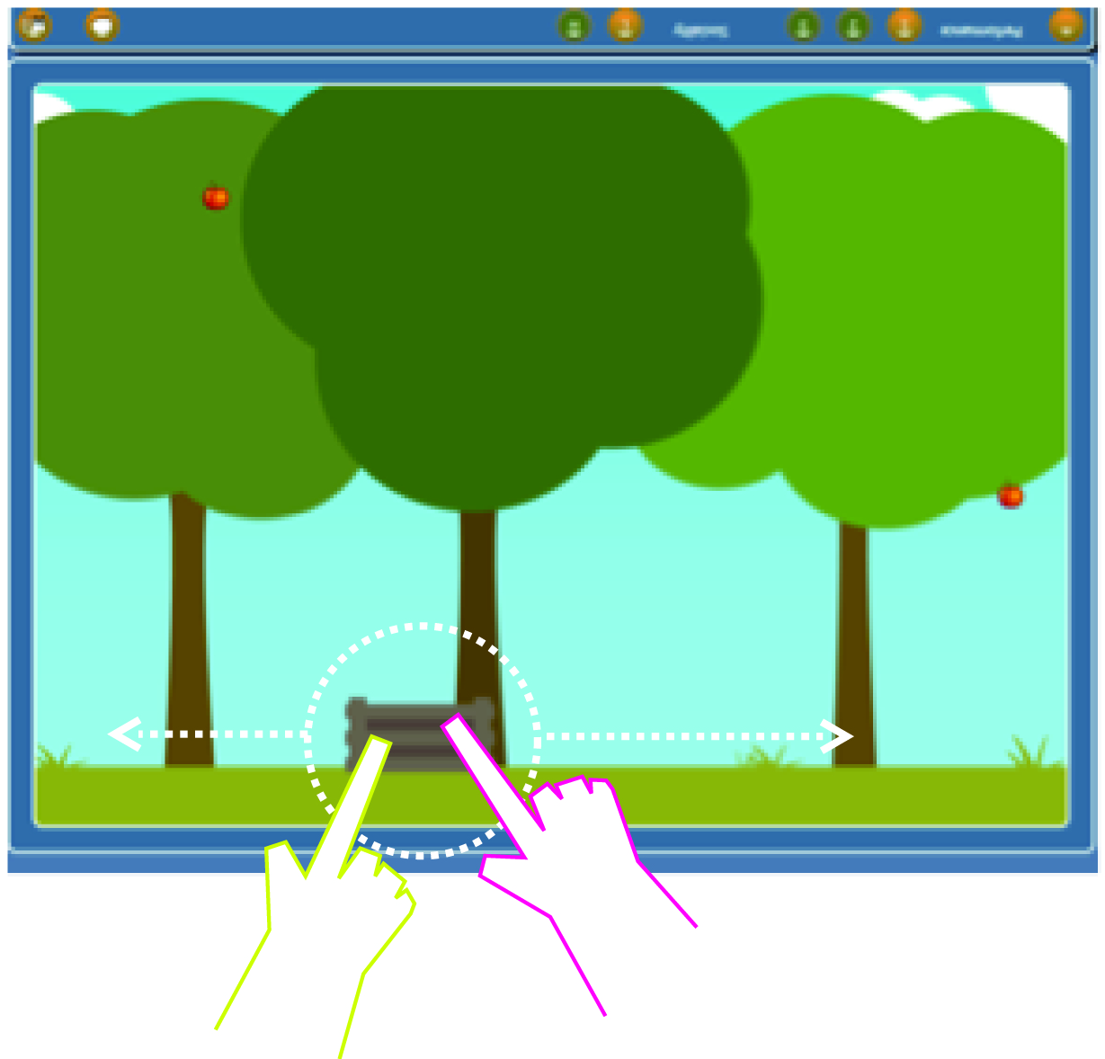
Apple Orchard - Constraint of objects + Joint performance
Social task- to collect enough apples for mom who wants to make a Jam.
Constraint of objects
The basket moves fast enough only if there is joint action: the two children NEED to move it together

Slide 20
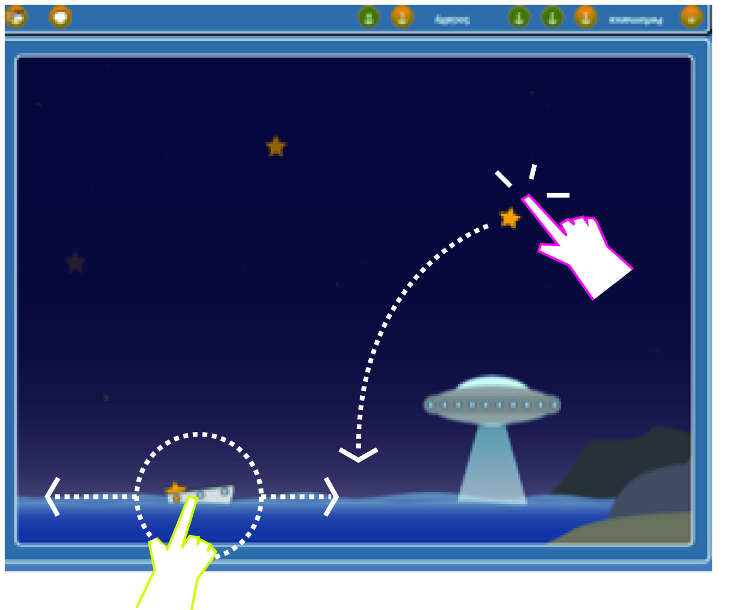
Save the Alien: constraints on roles + mutual planning
Social task: to collect stars to be used as fuel by an alien spaceship to be able to return home.
Different role pattern
One child catches the stars, other child moves the boat. System prevents child who moves the boat from also catching the stars and vice versa - mutual planning.

Slide 21
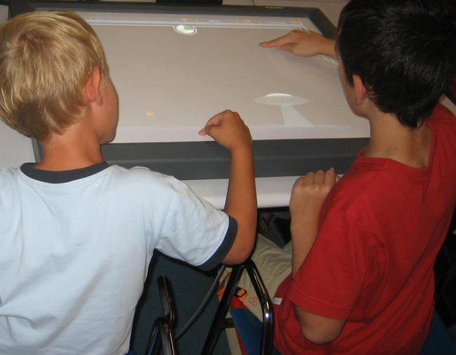
Pilot Data Collection
Focus groups (3)
    Occupational Therapists and Teachers
    Children with ASD
Exposure to three scenarios (both learning and experience parts) by 4 pairs of boys with ASD
Peer tutoring sessions

Slide 22
Questions from facilitators’ viewpoint
Adaptability:
  How does the facilitator adapt the game experience to fit the needs of the different children and their level of engagement?
  Is the software flexible enough?
  Are the social and difficulty levels appropriate?
Effectiveness:
Do the games support the educational objectives?
Does the system constitute an opportunity to set long-term interventions?
Could the game be integrated with everyday educational/therapeutic practice?

Slide 23
Questions from children’s viewpoint
Playability: are the games playable in the sense that the children understand the rules, and whether the ergonomics and usability are satisfactory?
Level of Engagement: do the games involve the players in a compelling, engaging and motivating experience?
Collaborative strategies: are there emerging collaborative patterns that the players elaborate to achieve the game goals?

Slide 24
Focus groups: Occupational Therapists and Teachers
software should encourage children to think of own alternative solutions, as well as the advantages and disadvantages of the presented alternatives
importance of having stories that relate to child's everyday life to allow better generalization
letting practitioner design a problem and “author” it within the technology interface

Slide 25
Focus groups: Children with ASD
upgrade the level of the animation; have it 3D if possible
insert various difficulty levels in each scenario
make the games work not only on the Diamond Touch table but also on a regular desktop computer
improve the touch screen because it is not always sensitive enough
make games more interesting, with thieves, police
make the games more challenging; harder games, different speeds. Apple orchard is way too easy.

Slide 26
Usability Testing Protocol
Demographic questionnaire about children were collected (including their prior exposure to and use of computer games)
2. Teacher/therapist introduced Join-In to the children; 3 stories/games: Apple Orchard, Bridge and Save the Alien
After each game, the Short Experience Feedback Questionnaire, Short Learning Feedback Questionnaire and connection between learning and experience question were administered
At the end of the session, the Intrinsic Motivation Inventory and Game Preference questionnaires were administered
Each child was then asked to prepare a 10-minute video guide of the system (“we need your help to make the video tutorial of this game for other users! Can you help us?”)

Slide 27
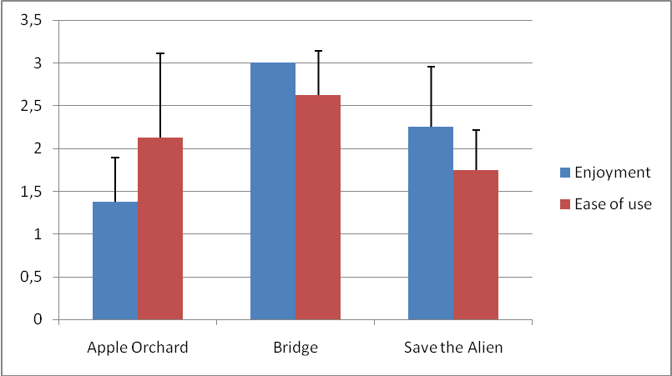
Enjoyment & Ease of Learning
Mean plus one SD of children’s Enjoyment scores where the scale goes from 1 (least enjoyable) to 3 (most enjoyable) and Ease of learning where the scale goes from 1 (least easy to learn) to 3 (easiest to learn).

Slide 28
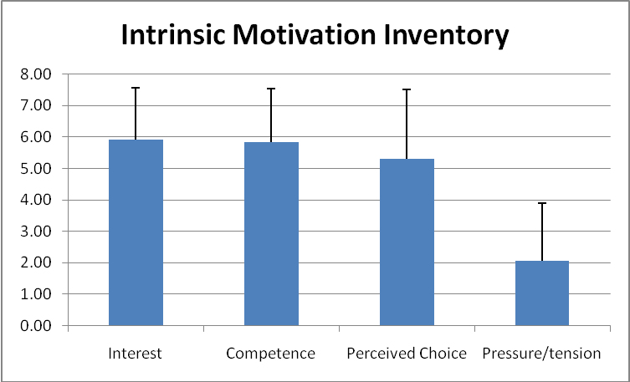
Mean plus one SD of children’s scores where the scale goes from 1 (low) -7 (high) for four categories (higher score indicates that the child was more interested in task, felt more competent doing task, perceived that he could make choices during the task, and felt less pressured and tense while doing the task).

Slide 29
Example Video Clips
2. Interchange between experience and learning
1. Enjoyment from games
4. Different role pattern: Alien
3. Choosing solution together

Slide 30
Conclusions
Results showed great enjoyment of the games as well as clear preferences amongst them.
Flexibility of software design enabled change to different social story (Apple Orchard → Raindrops)
Participants demonstrated proficient use of the collaboration patterns embedded within each game, showing a range of abilities in social competence.
Use of collaborative patterns embedded in the structure of the Join-In suite appeared to be effective in leveraging the engaging power of computer games as well as capturing a level of ecological validity which may not sufficiently present in computer games alone.
Next steps: evaluation study of Join In (and No Problem) for intervention with children with high functioning ASD

Slide 31
Try it out at the workshop!

