Slide 1
Toward a Population Parameter for "Communities of Inquiry" in Higher Education, Asynchronous
Course Forums
Paul Gorsky, Avner Caspi, Ina Blau & Yael David
Open University of Israel

Slide 2
Objective
Gorsky, Caspi and their colleagues (2010) calculated a bi-modal population parameter for the distribution of teaching presence, cognitive presence and social presence in asynchronous course forums based on disciplinary differences, group size and academic level.
This study attempts to corroborate these findings based on the analysis of an entire asynchronous course tran-script from an undergraduate history course forum at a campus-based college.

Slide 3
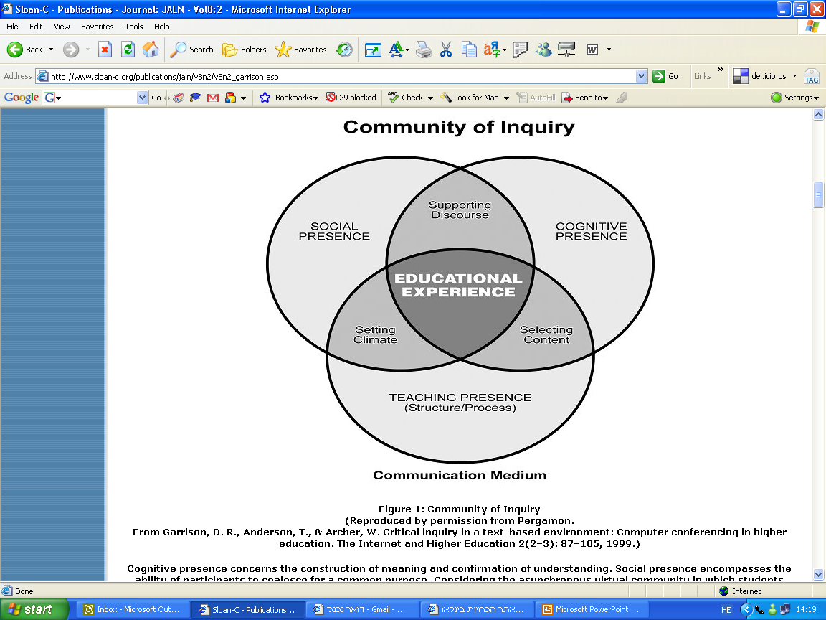

Slide 4
Cognitive Presence: “… the exploration, construction, resolution, and confirmation of understanding through collaboration and reflection in a community of inquiry”.
Teaching Presence: “… the design, facilitation and direction of cognitive and social processes for the purpose of realizing [students’] personally meaningful and educationally worthwhile outcomes”.
Social Presence: “… the ability to project one’s self and to establish personal and purposeful relationships”.

Slide 5
Methodology
Forum: History of War - 119 students; 29 (24.3%) posted at least one message.
Instruments:
- Course log site;
- Quantitative content analysis: message unit coded by categories. 188 messages - 86 posted by instructor (45.74%); 102 by students (54.26%). Inter-rater agreement = 92%.

Slide 6
Findings

Slide 7
Findings

Slide 8
Conclusions 1
Institutional differences
College students attended weekly lectures, had ample opportunity to talk with instructors and to establish friendships with classmates. As opposed to Open U. forums, the college forum was not a primary resource for learning (cognitive presence).

Slide 9
Conclusions 2
Toward a population parameter
Findings indicate the possible existence of a two dimen-sional population parameter for higher education, asynchronous course forums (“Communities of Inquiry”) that transcends academic discipline and level, group size and institutional difference.

