Slide 1
Higher Education At Distance: Assimilation of New Ways For Teaching and Learning at The Technion
Miri Barak, Rania Hussein-Farraj and Yehudit J. Dori

Slide 2
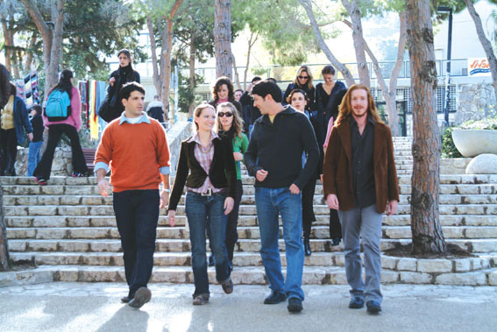

Introduction
In the current globalized world business and industry professionals are adopting life-long learning in order to keep up with innovations.
To cater to this increasing need, various forms of distance education have been on the rise over the last two decades in business, government, and higher education.
Distance learning (DL) enables professionals, individually or through their employers, to continue specializing in their workplaces at their own time and pace.

Slide 3
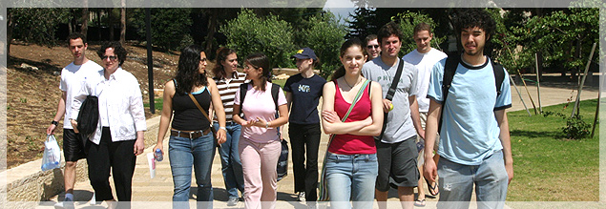
Distance learning
DL systems offer learners flexibility; learning can be conducted at the same time (synchronously) or at different times (asynchronously)
Higher education institutions have experienced dramatic growth in the use of DL systems (Allen & Seaman, 2010; Lee & Pituch, 2006).
However, whilst higher education institutions have invested substantial resources in DL, their pedagogical advantages as well as their cost-effectiveness are still to be examined.

Slide 4
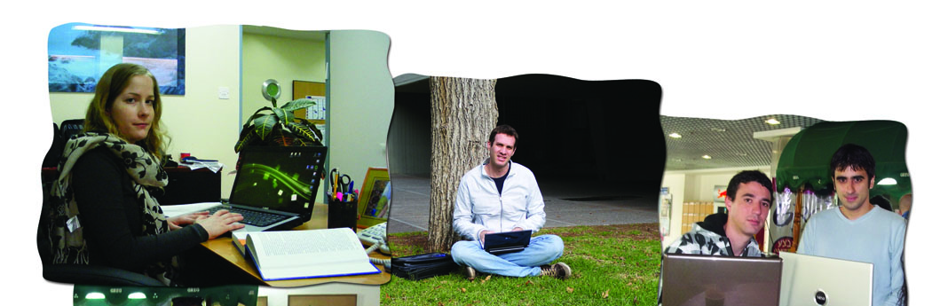
TIDES – Technion International Distance Education & Studies: Main Goals
Combining pedagogy with technology to position the Technion – Israel Institute of Technology, as one of the leaders in distance education for students in Israel and around the world.
Increase the number of graduate students at the Technion, especially from abroad.
Strengthen collaborations with academic and industrial partners inside and outside Israel.
Notes:
. Our study is the preface of a large research project that investigates the implementation of distance education and its effects on teaching and learning at the Technion- Israel Institute of Technology

Slide 5
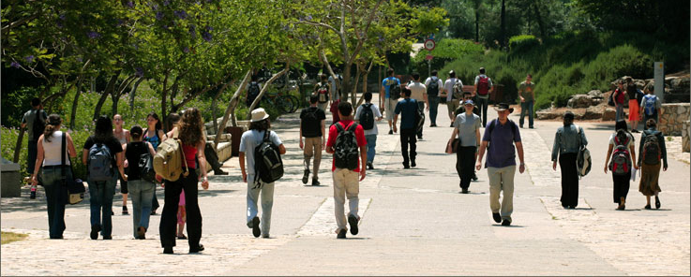
TIDES Framework
Courses for graduate students: engineers, scientist, and business people.
Courses are taught in various languages.
The lecturers receive pedagogical mentoring and technological support.
Using DL technologies and uploading the recorded lectures to the web.

Slide 6
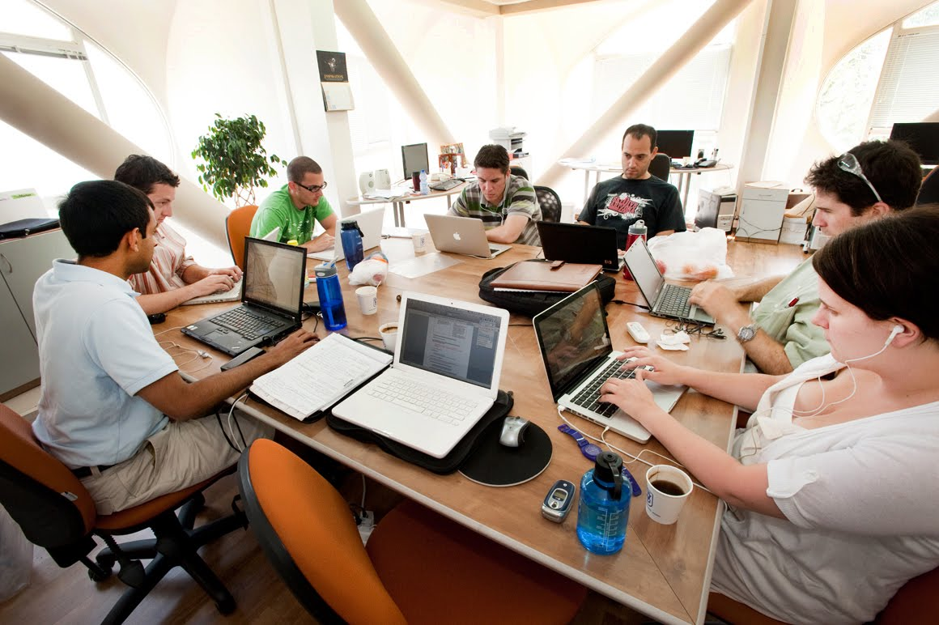
Research Goal
Our purpose was to examine graduate STEM students' attitudes and preferences about online distance learning.
Learning about students’ attitudes and preferences will assist in selecting the appropriate DL system and designing the online courses.

Slide 7
Research participants
The participants were 156 randomly selected graduate students from science, technology, engineering, and mathematic faculties at the Technion, professionals from: high-tech, pharmaceutical, space and aerodynamics, and communication companies in Israel.
Most of them (70%) studied their first degree at the Technion.
Most of them (80%) are at the ages between 25-to-34 years old.
More than 60% are males.
20% are department managers or head of teams in their workplace.

Slide 8
Research tool
Online survey with open-ended and close-ended questions.
The survey was administered at the first stage of the distance education initiative.
Includes 32 items on a 1-to-5 Likert type scale (5-strongly agree to 1-strongly disagree), divided into six main categories:
Meaningful learning
Techno-pedagogical benefits
Social aspects and communication
Course quality and students' support
Self-efficacy and self-assurance
Contribution to the workplace.

Slide 9
Findings
1. What are the graduate STEM students' attitudes about distance learning courses?
Although only 40% experienced DL, more than 70% of the business and industry persons asserted intent to participate in a DL course in the future.
Fig 1: Pro distance education (70%)
Fig 2: Opposing distance education (30%)

Slide 10
Findings
1. What are the graduate STEM students' attitudes about distance learning courses?
Table 1. Mean scores and standard deviations of the participants' attitudes and dispositions about online distance education (N=156)
Category | Mean | SD
Meaningful learning | 3.40 | 0.86
Pedagogical benefits | 3.75 | 0.88
Social aspects and communication | 2.90 | 0.94
Course quality and students support | 2.90 | 0.82
Self-efficacy and self-assurance | 3.80 | 0.90
Contribution to workplace | 3.60 | 0.85
Overall attitudes | 3.40 | 0.82

Slide 11
Findings
1. What are the graduate STEM students' attitudes about distance learning courses?
Qualitative analysis of the participants' explanations indicated that:
"Time" (saving time, time to think, managing time, working at the same time, etc.) was a theme that repeated itself among the participants' who were pro DL.
Whereas, "Lack of communication" (not being able to communicate with the lecturer, ask questions, interact with colleagues, etc.) was a theme that repeated itself among the participants' who were against DL.

Slide 12
Findings
2. What characterizes the graduate students who choose to enroll to a DL course?
No statistically significant differences were found between men and women, and between different age groups.
Participants who had prior experience in DL indicated significant higher positive attitudes about DL compared to their colleagues (F_{(1, 109)} =10.16, p<0.05).
Business persons with an engineering background asserted overall higher positive attitudes compared to other business persons in two main categories:
  Self-efficacy and self-assurance (F_{(1, 109)} =5.20, p<0.01)
  Contribution to workplace (F_{(1, 109)} =4.84, p<0.05)

Slide 13
Findings
3. Will students prefer to lean in a synchronous or a-synchronous mode?
60% of the participants would like the course to be delivered a-synchronically, 30% - both synchronic and a-synchronic, 10% - synchronic
Delivery mode | Category | Participants' explanation
asynchronic | Flexibility in time and place | I prefer a-synchronic learning because I have a young child and this gives me the option to study on my own time.
 | Independence and self-responsibility | I like learning alone, a-synchronic learning provides a good tool for me to learn on my own.
Synchronic | Stable learning framework | I am afraid that I will not be diligent enough because my self-discipline is quite low.
 | Real time communication with the lecturer | I need to see the lecturer’s face and body expressions when he answers my questions.

Slide 14
Lessons learned
Most of the students are interested in participating in DL courses.
They expect that DL courses will make their learning more efficient and meaningful.
Good and efficient communication between the students and the lecturer and between themselves, should be one of the major concerns in selecting DL technologies.
As a result, we designed, developed and implemented a framework for DL.

Slide 15
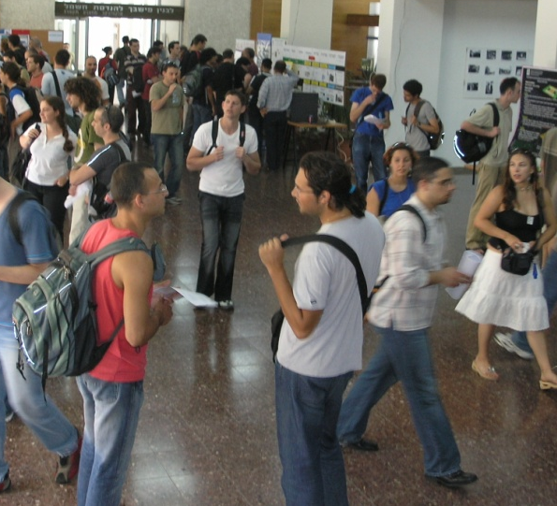
TIDES Framework: Design-based Principles
Providing tools for promoting higher order thinking (creative, critical, logical).
Providing explanations exactly when needed.
Integrated relevant and authentic case-studies as part of the learning process.
Encouraging knowledge sharing and collaboration among students.
Involving students in active learning while developing complex projects.

Slide 16
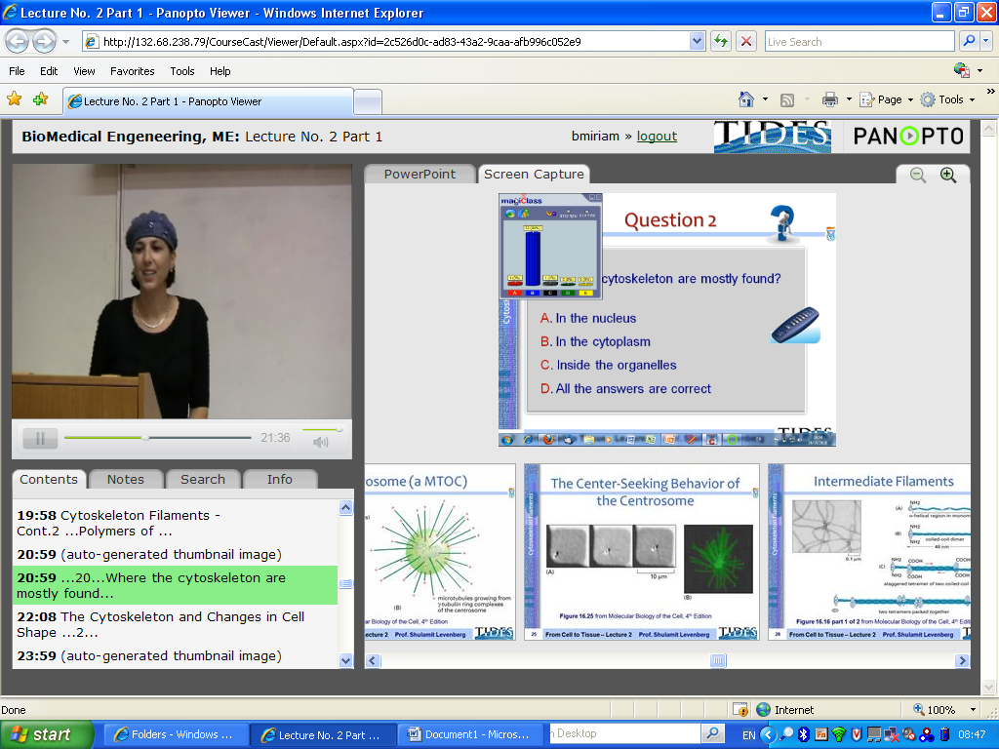
TIDES Distance Learning Technologies

Slide 17
Thanks
Miri Barak, Rania Hussein-Farraj, and Yehudit J. Dori

